Slide 1
Cross-platform testing with Chef and DSC on Azure
Stuart Preston
@stuartpreston
#psconfasia

Slide 2


About me
Co-founder & Technical Director at Pendrica
Microsoft Azure MVP
Open Source Contributor
Awesome Community Chef!
Author "Using Chef with Microsoft Azure" http://bit.ly/chefazure
Twitter: @stuartpreston

Slide 3
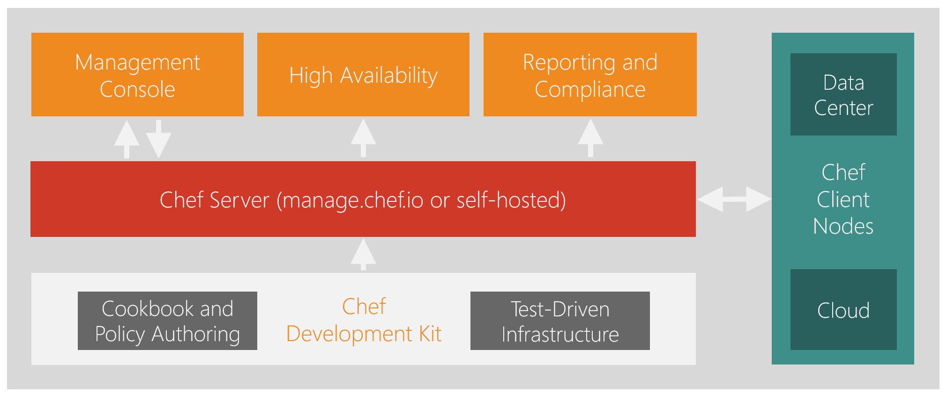
Chef Overview

Slide 4
Chef Overview

Slide 5

What is Test Kitchen?
Framework built in Ruby for cross-platform testing and to support Chef Cookbook development - see http://kitchen.ci
Uses the language to verify expected outcomes
Bundled with the Chef Development Kit (ChefDK)
Compliance as code? Yes! (see also: Chef commercial offerings)
describe package('httpd') do
it { should be_installed }
end
describe windows_feature('Web-Server') do
it { should be_installed }
end

Slide 6


Test Kitchen "kitchen test" process
CREATE
Azure Resource Manager (ARM)
CONVERGE
Chef Client (via SSH/WinRM)
VERIFY
InSpec (via SSH/WinRM)
DESTROY
Azure Resource Manager (ARM)

Slide 7
DEMO
Wouldn't it be great if we could automate the installation and configuration of PowerShell Core and DSC across Windows Server, Nano Server and Linux distributions and to be able to automatically verify our Infrastructure as Code?

Slide 8
Just to recap…
Test Kitchen, running both on Windows 10 client and WSL (Bash on Ubuntu on Windows)
Test Kitchen Azure Resource Manger driver, allowing us to spin up instances to test our Infrastructure as Code in the Azure cloud*
Chef allowed us to automate the DSC and PowerShell configuration cross-platform
Built-in functionality that exists today for dsc_script (and dsc_resource) on Windows
We built a "custom resource" to mimic the same behaviour on Linux
InSpec - single set of verification tests
Integration test for outcomes not "code coverage"
* other drivers are available…

Slide 9
Get the bits
Learn Chef: http://learn.chef.io
Chef Development Kit: http://downloads.chef.io/chef-dk
Visual Studio Code: http://code.visualstudio.com
Test Kitchen: http://kitchen.ci
Chef Docs: http://docs.chef.io
Azure Resource Manager driver for Test Kitchen http://github.com/pendrica/kitchen-azurerm
Don't forget the book! http://bit.ly/chefazure

